Slide 1
SCHOLARSHIP WORKSHOP
KEA Meeting
February 8, 2025
Trish Halstead, Scholarship Chair
trishh@twinvalley.net
785-632-0035

Slide 2
2025 MVS TIMELINE
MVS Application Open - August 1, 2024
MVS Portal Open - August 1, 2024
MVS Application Close - November 12, 2024
Counselor Report Close - November 19, 2024
Lodge Judging - December 6 - 23, 2024
Notification for Districts - December 30, 2024
District Judging - January 3 - 14, 2025
Quarter Finalist Application Open - Jan. 17, 2025
Quarter Finalist Application Close - Feb. 3, 2025
State Judging - February 6 - 24, 2025
Semi-Finalist Application Open - Feb. 28, 2025
Semi-Finalist Application Close - March 12, 2025
National Judging - March 14 - 24, 2025
National Finalists Announced - Late March, 2025
Leadership Weekend - May 1 - 4, 2025
2025 STATE JUDGING
Clay Center Elks Lodge 2253
611 5th Street, Clay Center
Saturday, February 15, 2025
9 AM
Let Trish Halstead know if you can help! Text 785-632-0035

Slide 3
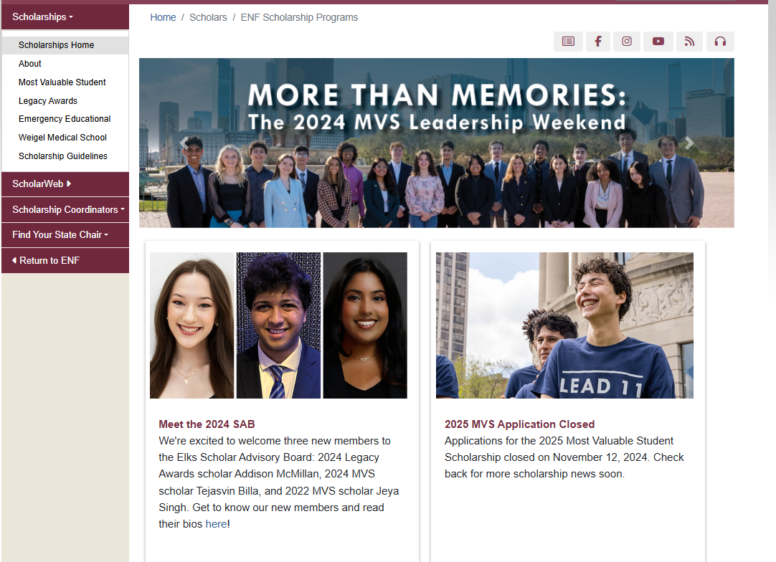
https://www.elks.org/scholars/
Most Valuable Student
Legacy
Emergency Education
Weigel Medical School
ER must appoint a Lodge Coordinator
SECRETARY must record Lodge Coordinator in CLMS
LODGE COORDINATOR must have elks.org login and be knowledgeable of scholarship dashboard and scoring.

Slide 4
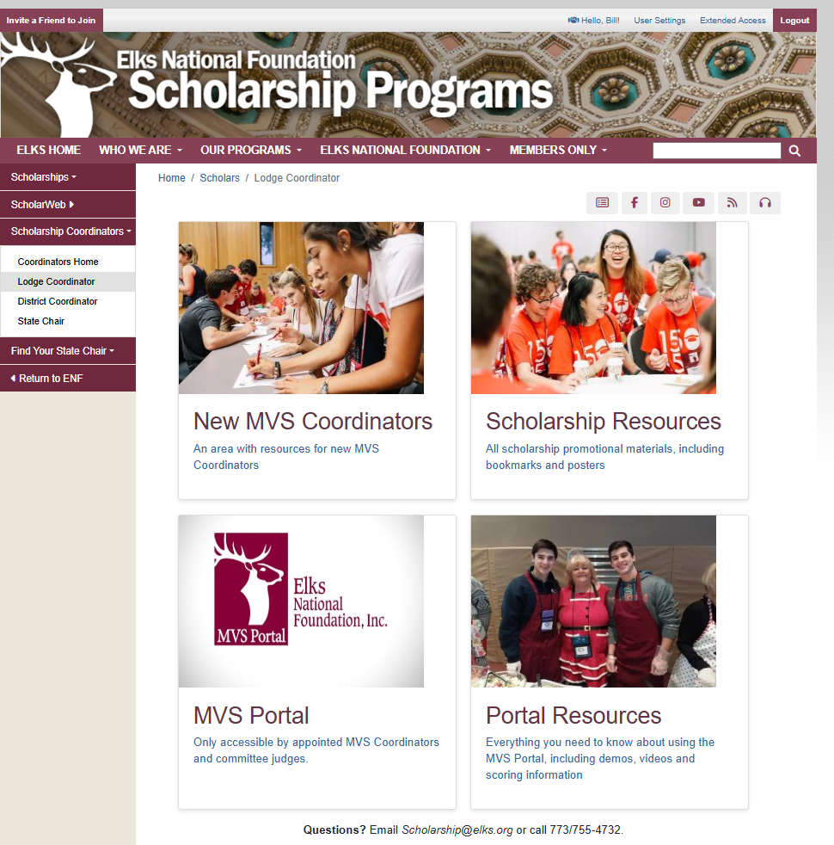
LODGE COORDINATOR
New MVS Coordinator
Scoring information
Scholarship Resources
Media, Social Media, Posters, etc
MVS Portal
Score, Review, Print Applications
Portal Resources

Slide 5
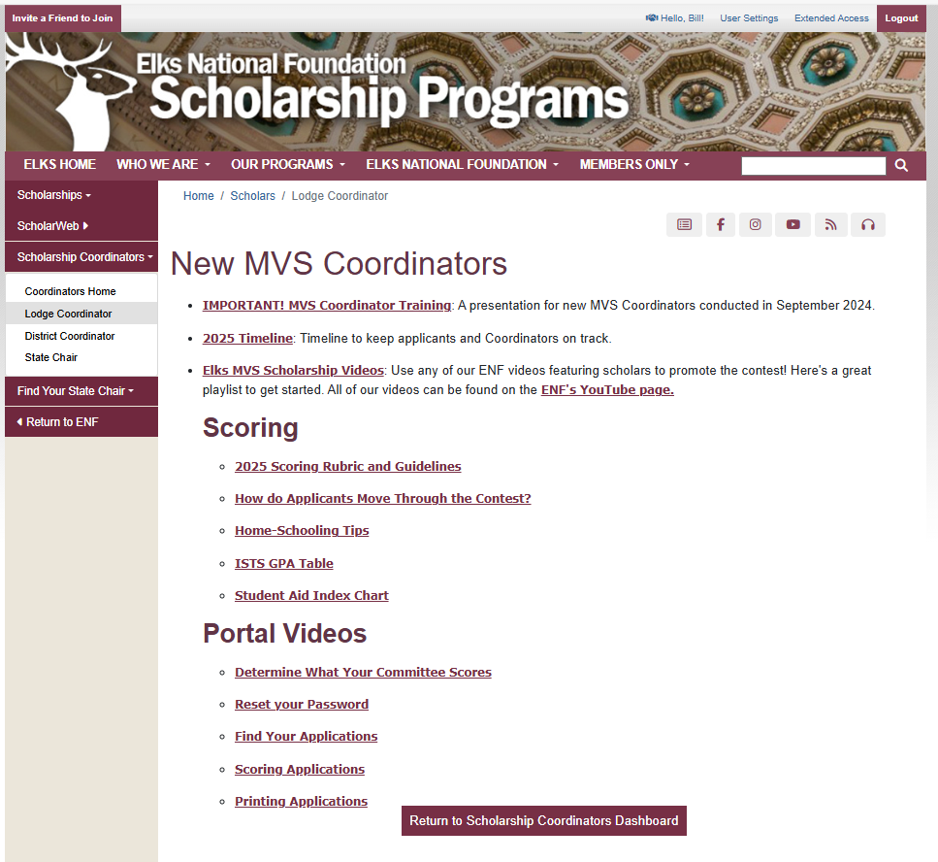

Slide 6
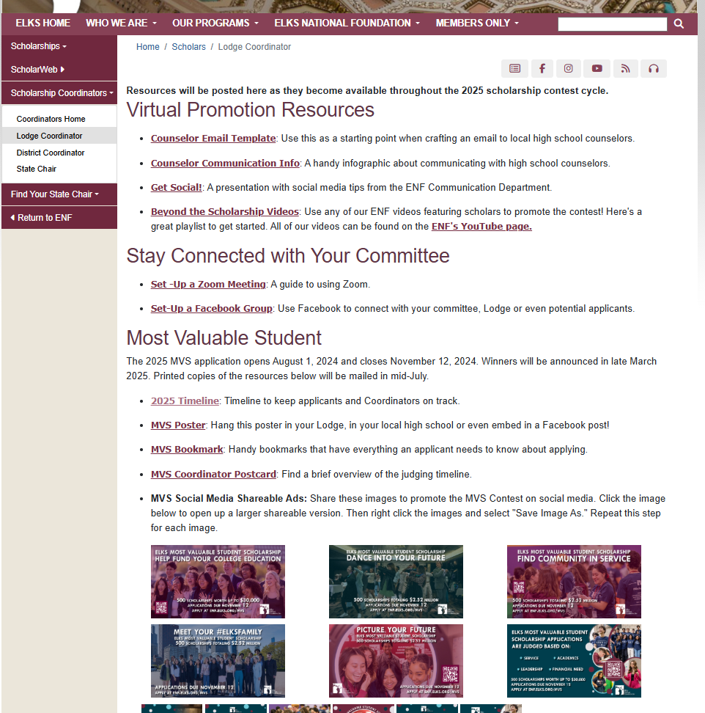
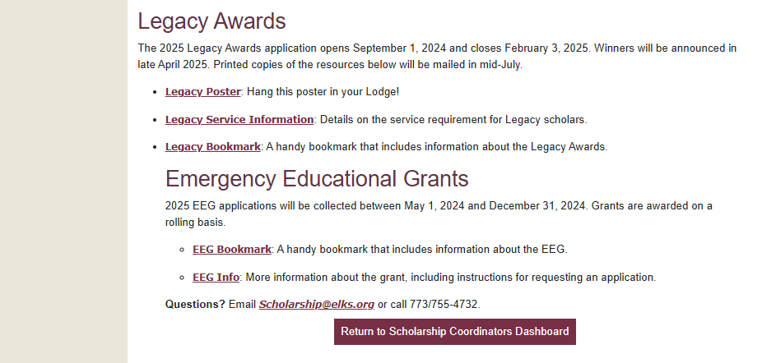

Slide 7
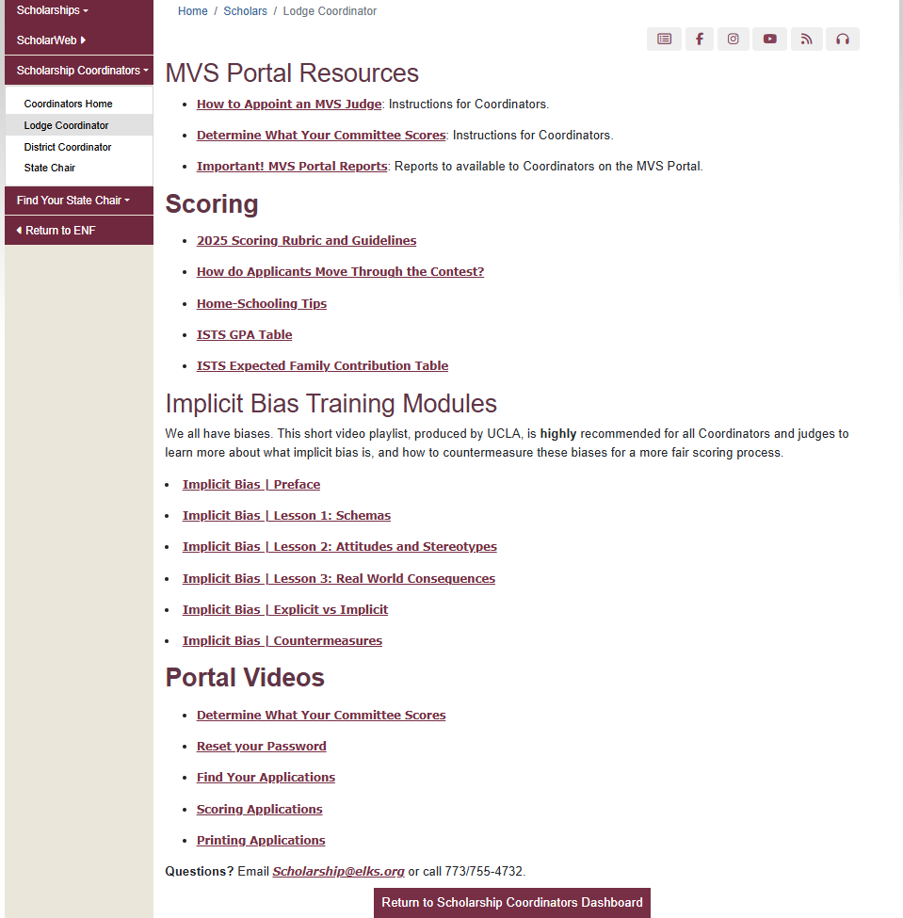

Slide 8
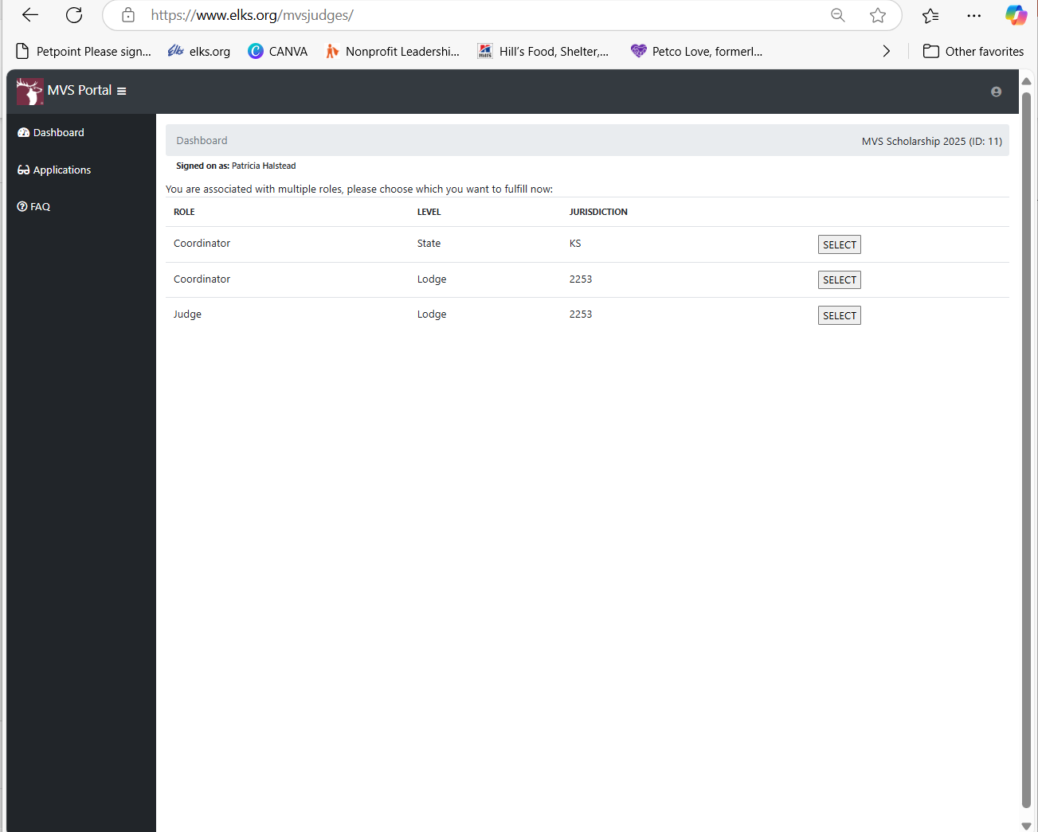
This page will look different based on responsibilities.

Slide 9
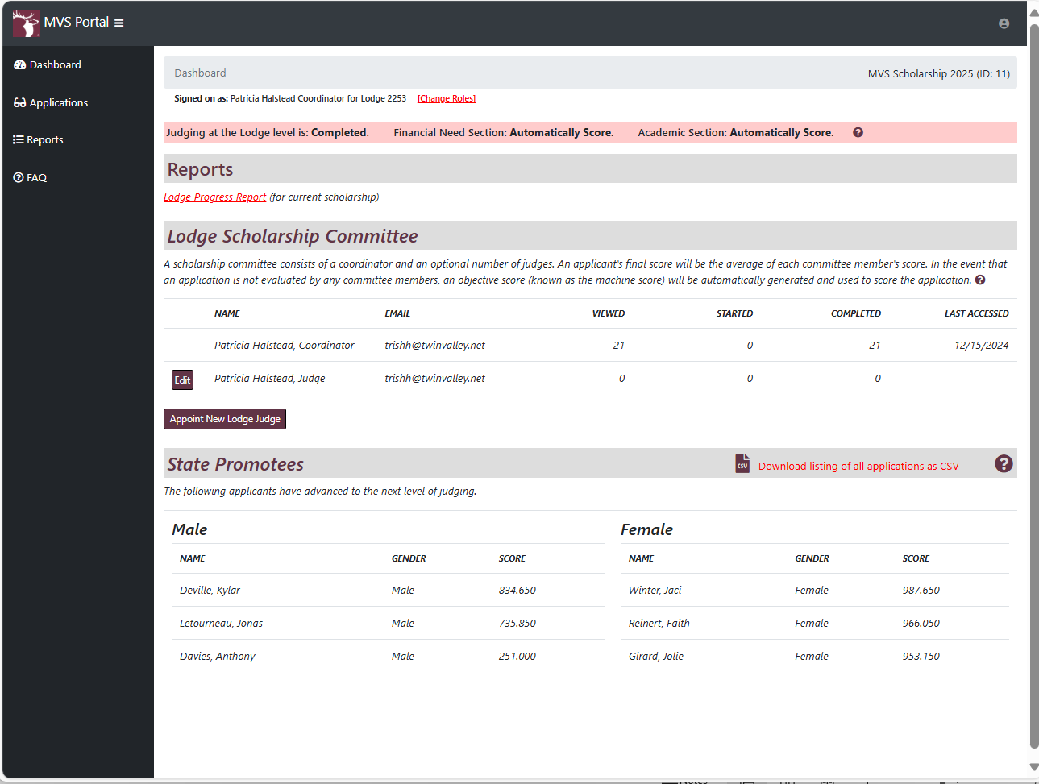
NOTE: This screen will look different before you score the applications!
Dashboard Options:
Applications
Reports
FAQS
Before Lodge Judging Start Date – Lodge has the option to mark the system to Automatically Score “Financial Need Section” and/or “Academic Section”.
Scoring
Lodge Judges score each section of application 0-10.
System (machine scores) will convert scores to 0-1,000 points depending on section.
(Names have been blacked out for privacy.)

Slide 10
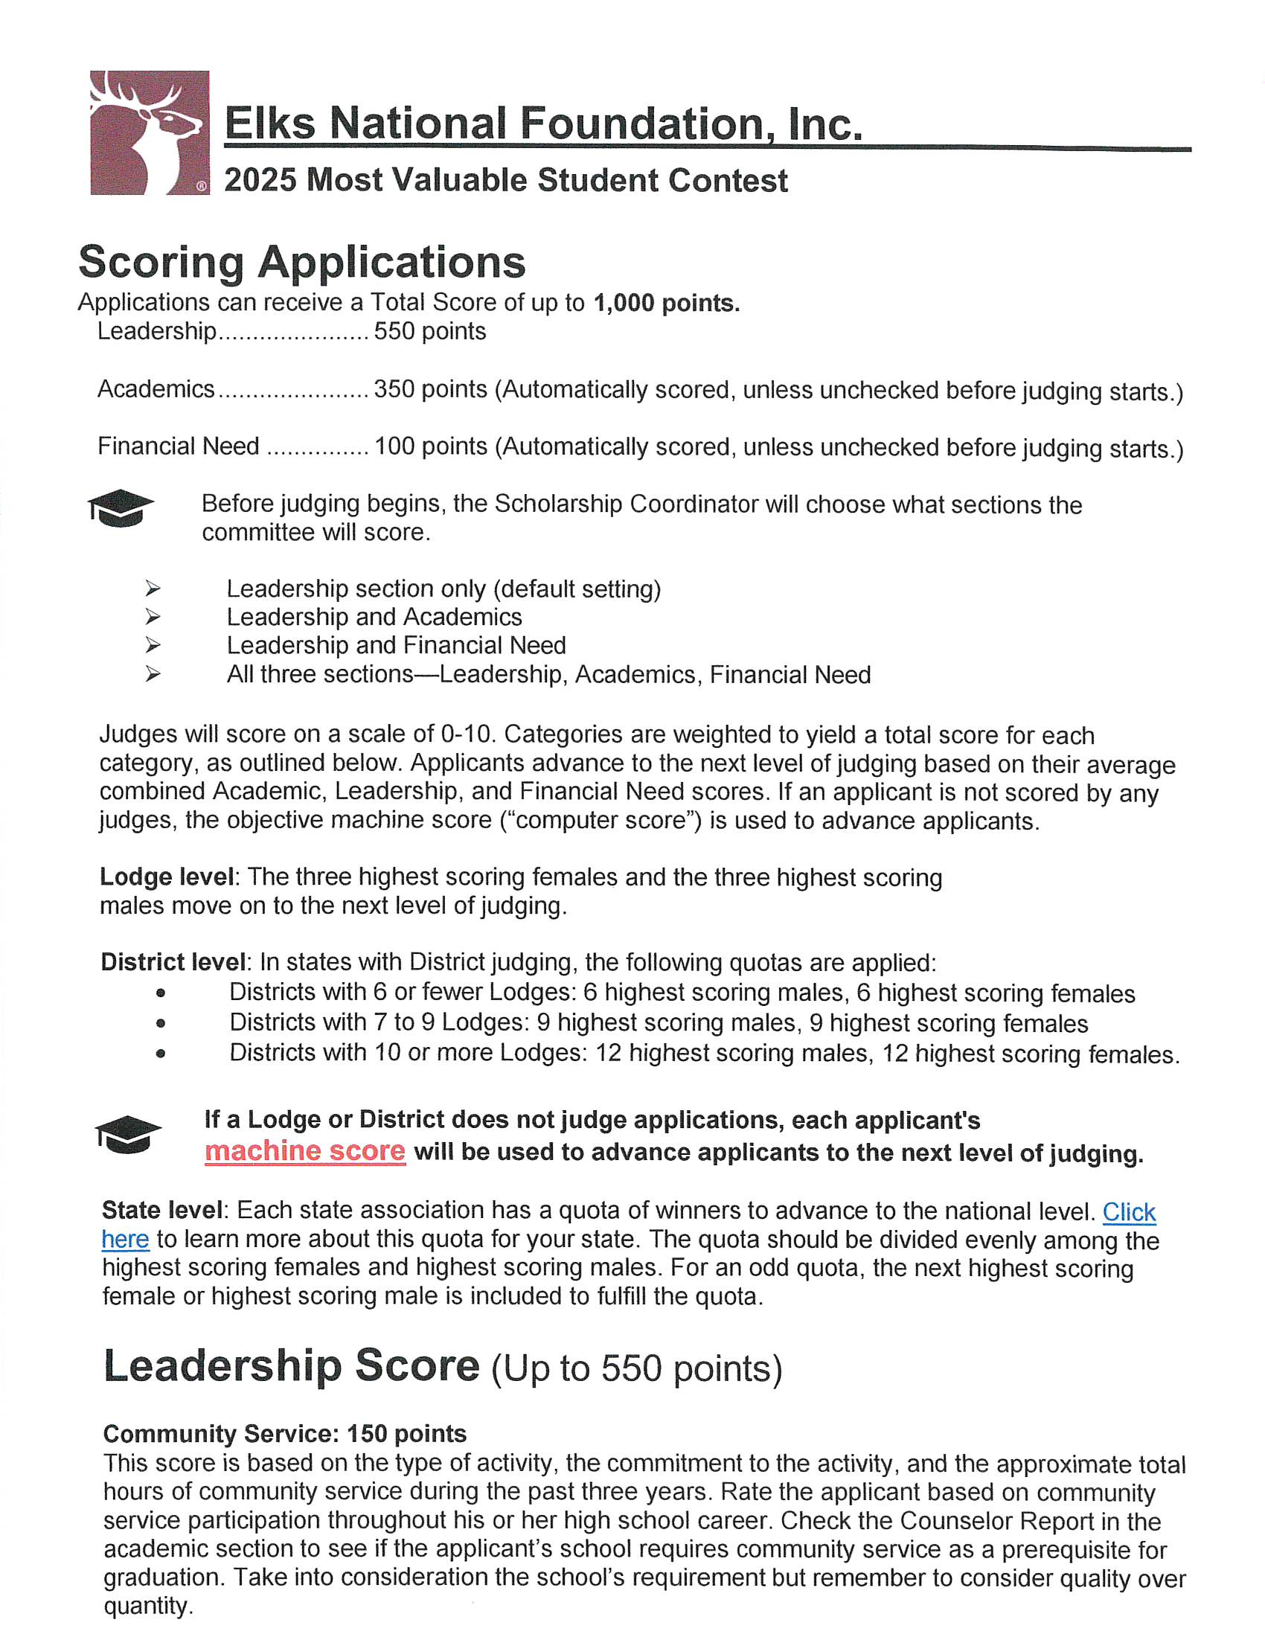
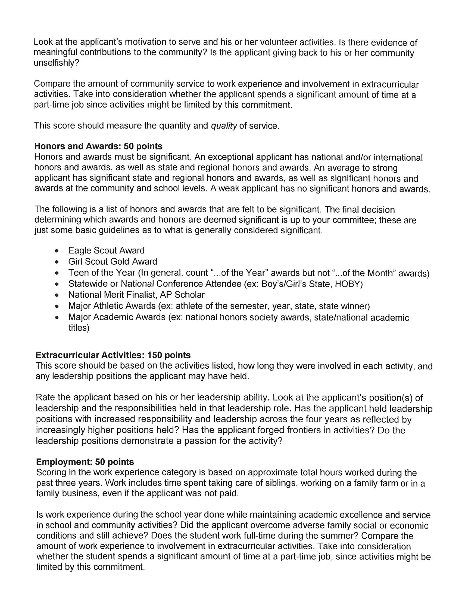

Slide 11
